Slide 1
Hardware-Accelerated Convolutional Neural Networks on RISC-V Processor Integrated with FPGA
ACHUTHA ASWIN NAICK
2nd Year ECE
College of Engineering Trivandrum

Slide 2
CONTENTS
Zynq 7000 Series FPGA Development Board (ZedBoard)
32-bit 5-stage pipelined RISC-V (RV32I) Processor in Verilog HDL
Custom AXI4 Stream IP generation
Implementation of Neural Networks in Verilog HDL
Integration of RISC-V processor and Neural Networks
Results
Next Task
Extras

Slide 3
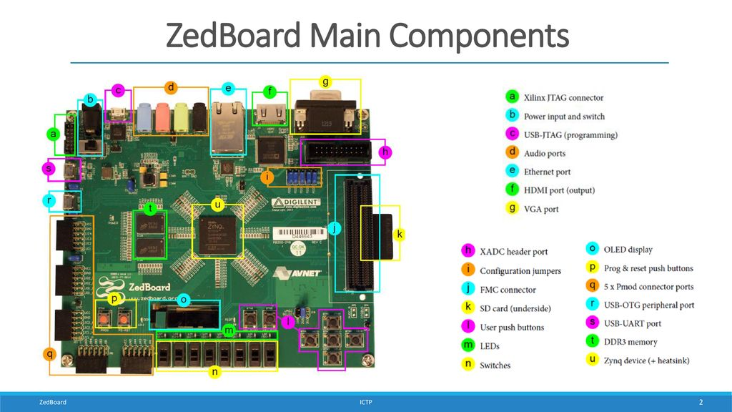
Zynq 7000 FPGA Development Board (ZedBoard)
(Source: Digilent Zynq 7000 ZedBoard datasheet)

Slide 4
Why ZedBoard?
Zynq SoC: Dual-core ARM Cortex-A9 + Artix-7 FPGA ideal for HW/SW design
RISC-V on FPGA: Deploy pipelined RISC-V core in FPGA fabric for full control of dataflow and logic
AXI Interconnect: High-speed PS ↔ PL communication for data transfer and accelerator control
512MB DDR3 RAM: Shared memory for MNIST image data, model weights, biases and intermediate buffers
Neural Network Acceleration: FPGA used for CNN layers, ReLU, Sigmoid, fully connected layers using fixed-point representation logic
Toolchain Support: Works with Vivado, Vitis
Edge AI Ready: Compact, low-power system ideal for real-time digit classification in embedded settings

Slide 5
Overview of ZedBoard
Dual Core ARM Cortex-A9 (Processing System (PS)) : Controls overall flow, loads MNIST image data, initiates classification
Artix-7 FPGA (Programmable Logic (PL)) : Implements RISC-V core + accelerates Neural Network computations
PS-PL Link : AXI Interconnect Interface; Moves image pixels from PS to PL, retrieves predictions

Slide 6
Day-Wise Progress
6th June: Explored ZedBoard and studied its datasheet.
7th June: Implemented RISC-V Add and Immediate instructions.
8th June: Learned RISC-V ISA formats (R/I/S); designed 32-bit ALU.
9th June: Created ALU Decoder, Main Decoder, and memory/mux components.
10th June: Built pipeline registers, writeback mux, regfile, PC mux.
11th June: Completed datapath, controller, hazard unit; tested ZedBoard OLED.
12th June: Started Neural Networks; learned Perceptrons and bias.
13th June: Covered Sigmoid/ReLU concepts; intro to digit classification.
16th June: Explored activation functions; designed single neuron in Verilog.
17th June: Implemented ReLU/Sigmoid, designed NN layers, learned AXI/DMA.
18th June: Integrated NN with AXI/DMA; achieved 90–98% accuracy.
19th June: Created ZyNet IP and interfaced with Zynq PS via AXI.
20th June: Bitstream generated; hardware exported for final deployment.
23rd June: Started image processing; designed line buffer and MAC unit.
24th June: Implemented control logic for buffer/mux; handled pixel data.
25th June: Designed testbench for image processing logic.

Slide 7
Section I: RISC-V Processor
32-bit RISC-V 5-stage pipelined Processor Implementation in Verilog HDL

Slide 8
Why Choose RISC-V?
Modular and Scalable
Supports base integer instructions (RV32I)
Integration-friendly for hardware accelerators (e.g., MNIST classifier)
Optimized for Efficiency
Simple, clean instruction set
Supported by a large, growing ecosystem of compilers and tools
Flexible for Both Software and Hardware Co-Design
Facilitates tight integration between processor and custom IPs on FPGAs

Slide 9
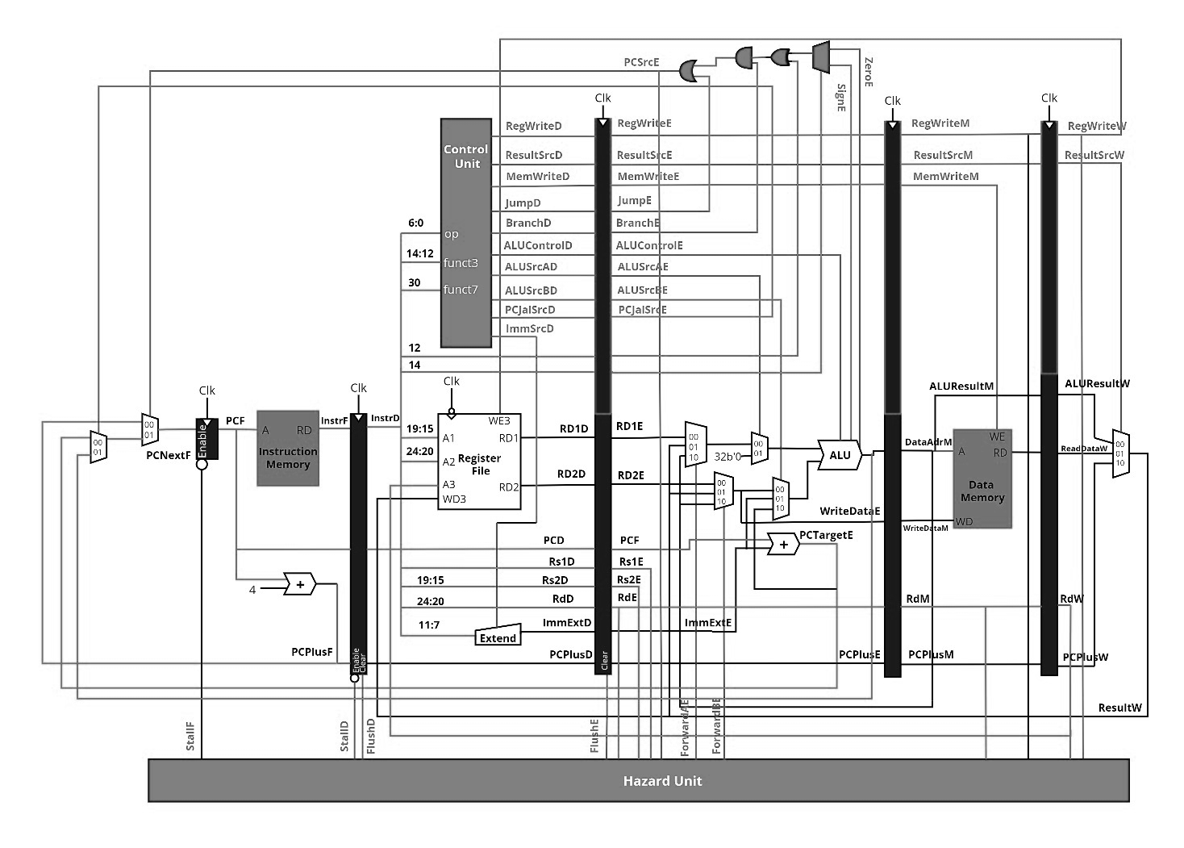
32-bit RISC-V Processor: Complete Diagram

Slide 10
Modules Implemented in Verilog HDL
Components
Main Decoder
ALU
Memory
Data Memory
Instruction Memory
Immediate Extend
Forwarding Units (A , B)
Datapath Pipeline Registers
Controller Pipeline Registers
Supporting Modules
ALU Decoder
Program Counter MUX
Register File
IF/ID Register
ID/EX Register
EX/MEM Register
MEM/WB Register
ID/EX Register (CTRL)
EX/MEM Register (CTRL)
MEM/WB Register (CTRL)
Adder
2x1 MUX
4x1 MUX
Reset Flip-Flop
Write Back MUX
Integration
Controller
Datapath
Hazard Detection Unit
RISC-V Integrated
RISC-V top
Tool used: AMD Vivado 2023.2

Slide 11
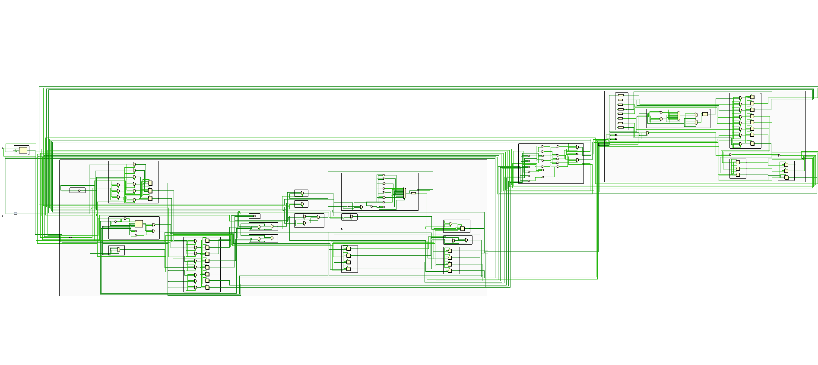
RISC-V RTL Design
Tool used: AMD Vivado 2023.2
RTL Analyzer

Slide 12
Section II: Custom AXI-4 Stream IP
Custom AXI4 Stream IP Block Design generated for testing Inverting functionality

Slide 13
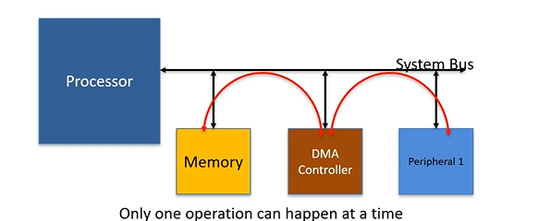
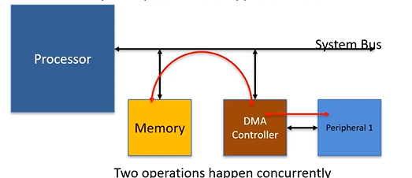
Configuration of DMA Controller
Slower DMA controller
Faster DMA controller
(Drawback: one DMA Controller for one peripheral)

Slide 14
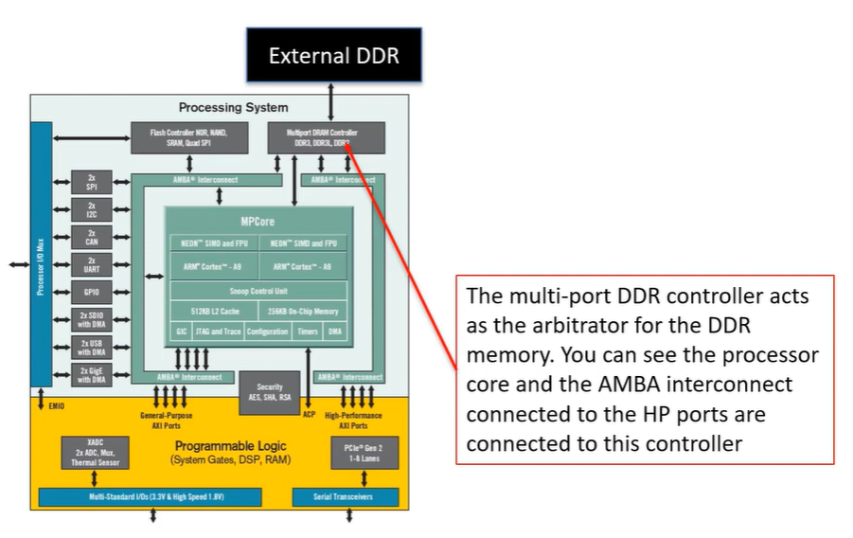
Overview of DMA on Zynq
512MB DDR3: This will store image weights, biases

Slide 15
AXI (Advanced eXtensible Interface) [Some Terminologies]
AXI:
Memory mapped
Full interface
Has Bursting (bursting refers to a high-performance data transfer feature where multiple data words are transferred in one transaction rather than one at a time. This improves throughput and reduces latency and overhead.)
AXIS:
Not Memory mapped
Directly point to point interface between Master and Slave
AXI Lite:
Memory mapped
Simple and low throughput interface

Slide 16
Overview of AXI Interface
Feature | AXI (Full) | AXI Lite | AXI Stream (AXIS)
Memory Mapped | ✅ Yes | ✅ Yes | ❌ No
Point-to-Point | ❌ No (via interconnect) | ❌ No | ✅ Yes (direct Master ↔ Slave)
Bursting Support | ✅ Yes | ❌ No (only single beat transfers) | ✅ Yes (continuous stream, no address)
Use Case | High-throughput data (DMA, memory) | Configuration, register access | Real-time streaming (video, sensors)
Complexity | High | Low | Medium

Slide 17
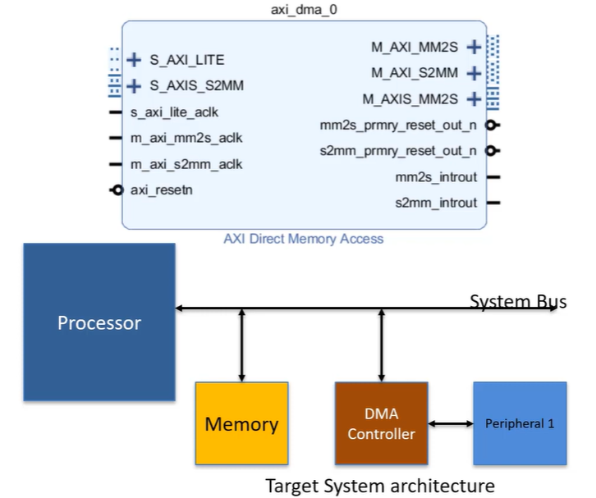
Xilinx DMA IP (Xilinx AXI DMA)
S_AXI_LITE: interface for configuring DMA from processor (AXI4-Lite protocol)
S_AXIS_S2MM: read interface from peripheral to DMA (AXI Stream protocol)
M_AXI_MM2S: read interface from Memory to DMA (AXI4 Full protocol)
M_AXI_S2MM: write interface from DMA to Memory (AXI4 Full protocol)
M_AXIS_MM2S: write interface from DMA to peripheral (AXI Stream protocol)
***MM2S: Memory Mapped to Stream
***S2MM: Stream to Memory Mapped
(performance higher than AXI Lite)

Slide 18
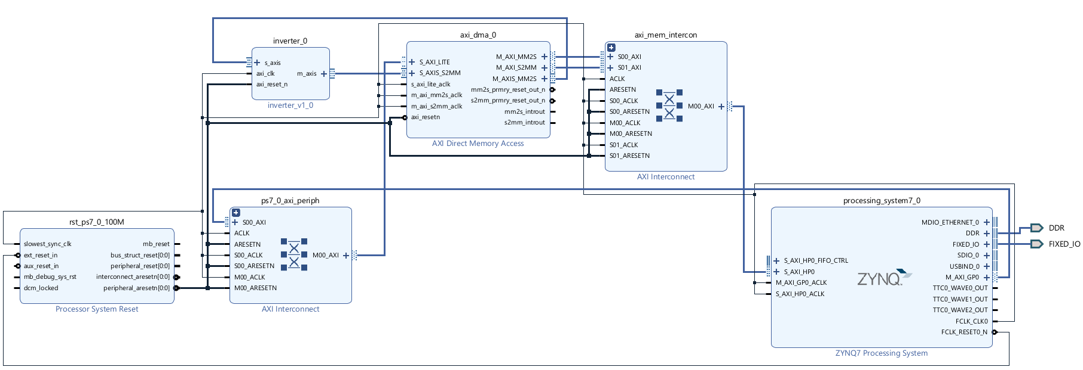
AXI-4 Stream IP Testing (Inverter)
DMA System level Design with AXI interface
Tool used: AMD Vivado 2023.2 IP Packager

Slide 19
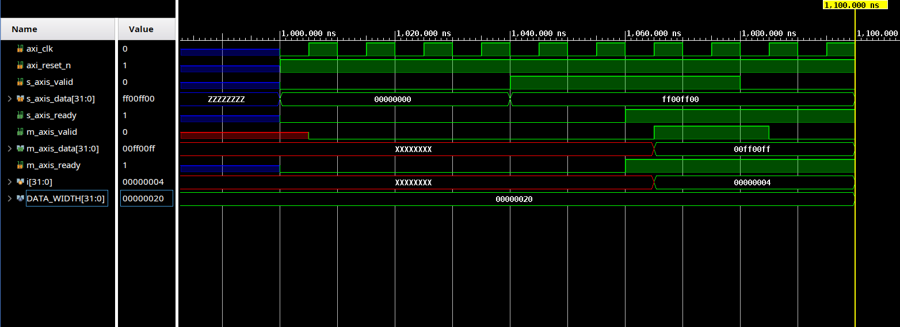
AXI-4 Stream IP Simulation Waveform (for an Inverter)
Tool used: AMD Vivado 2023.2
Simulation

Slide 20
Section III: Neural Networks
Implementation of MNIST Dataset recognition using a fully connected Convolutional Neural Network

Slide 21
Dataset
MNIST Dataset: Contains 28x28 grayscale images of handwritten digits (0–9).
Flattening: Each image is converted into a 784-length (28×28) 1D array of pixel values.
Normalization: Pixel intensities (0–255) are scaled to range [0, 1] or [-1, 1] for better learning.
Binary Conversion: Normalized values are quantized and represented in binary (fixed-point format) for FPGA compatibility.
Memory Storage: Binary pixel data is stored in FPGA memory (e.g., BRAM) for input to the CNN.
Efficiency: Preprocessing simplifies data transfer and speeds up inference on FPGA hardware.

Slide 22
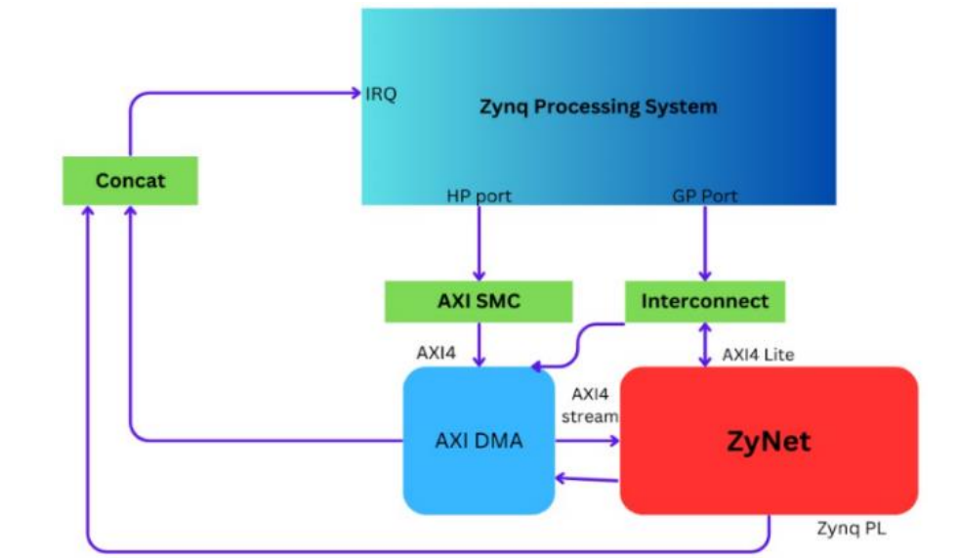
System Architecture

Slide 23
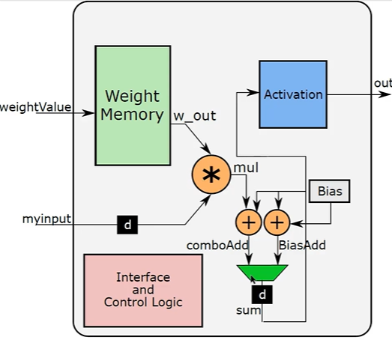
CNN Network Design of a Single Neuron

Slide 24
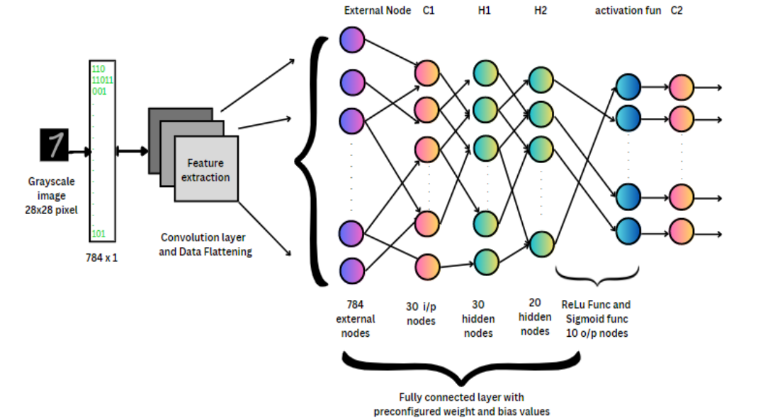
Layer Design
Parallel Input: All 784 input nodes send
data simultaneously via AXI interface.
Data Flattening: 28×28 image is reshaped into a 1D array to match neuron inputs.
Weight & Bias Multiplication: Each input
is multiplied with its weight and added to
bias.
Pipelined Architecture: Enables
overlapping of operations across layers
for high throughput.
Epoch-Based Execution: This process repeats throughout all training and testing epochs.
10

Slide 25
Module Implemented in Verilog HDL
Layer
Layer 1
Layer 2
Layer 3
Layer 4
Memory Instantiation Functions
w_x_y
b_x_y
Sigmoid Content
Basic Structure
Neuron
Memory
AXI Lite Wrapper
Sigmoid ROM
Weight Memory
ReLU
Max Finder (Softmax)
ReLU Content

Slide 26
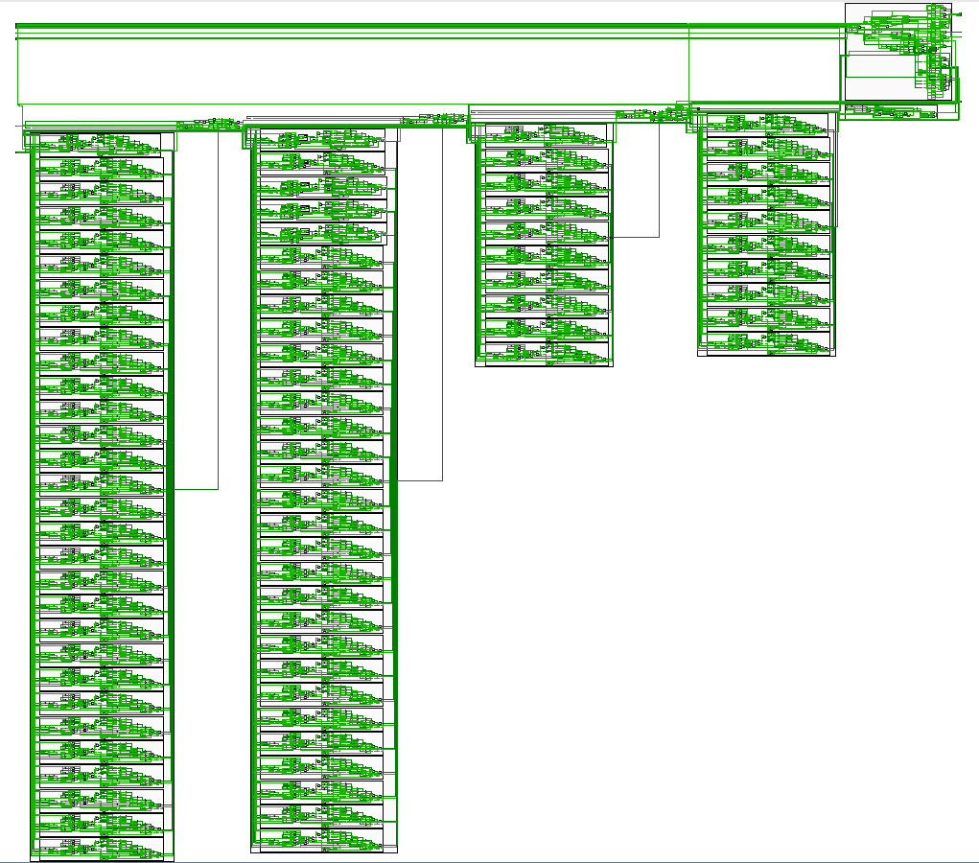
Neural Networks (zynet) RTL Design
Tool used: AMD Vivado 2023.2
RTL Analyzer

Slide 27
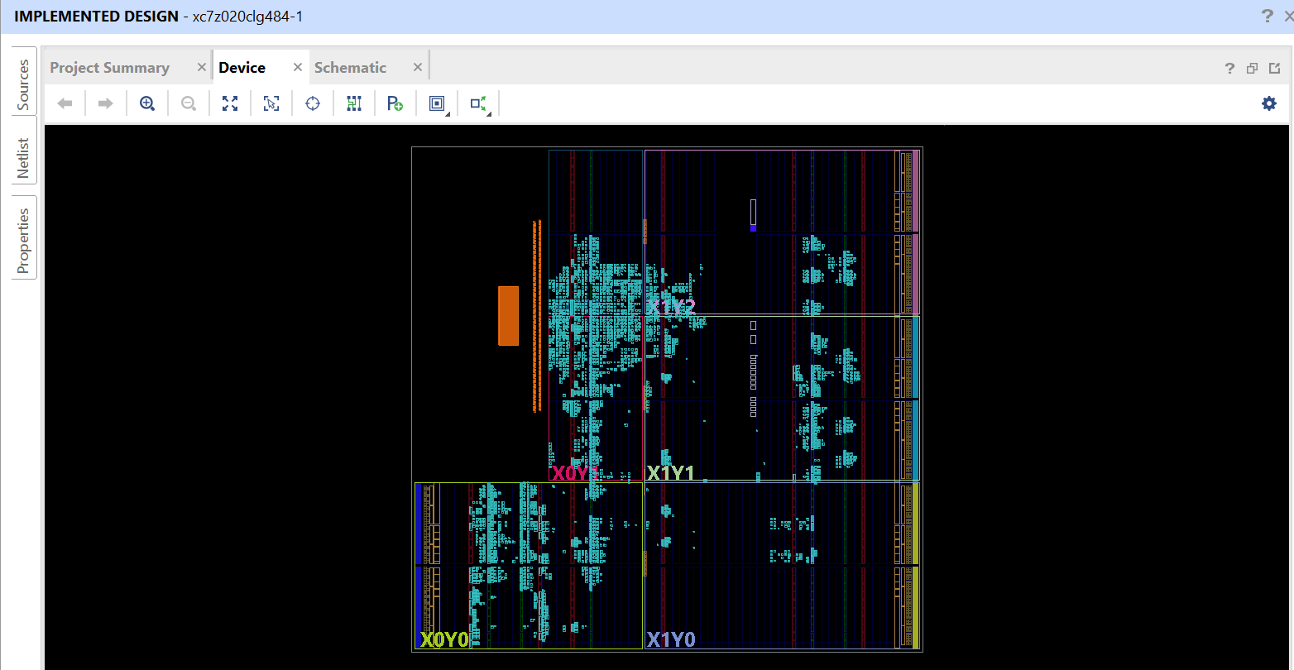
Neural Network Implementation Device Results

Slide 28
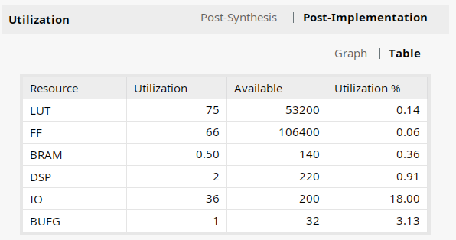
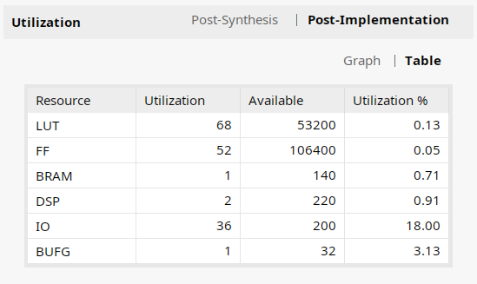
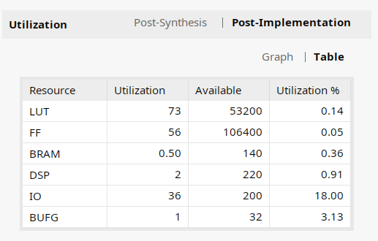
Resource Utilization Data for different Functions
ReLU
Sigmoid Size 10 Sigmoid Size 5

Slide 29
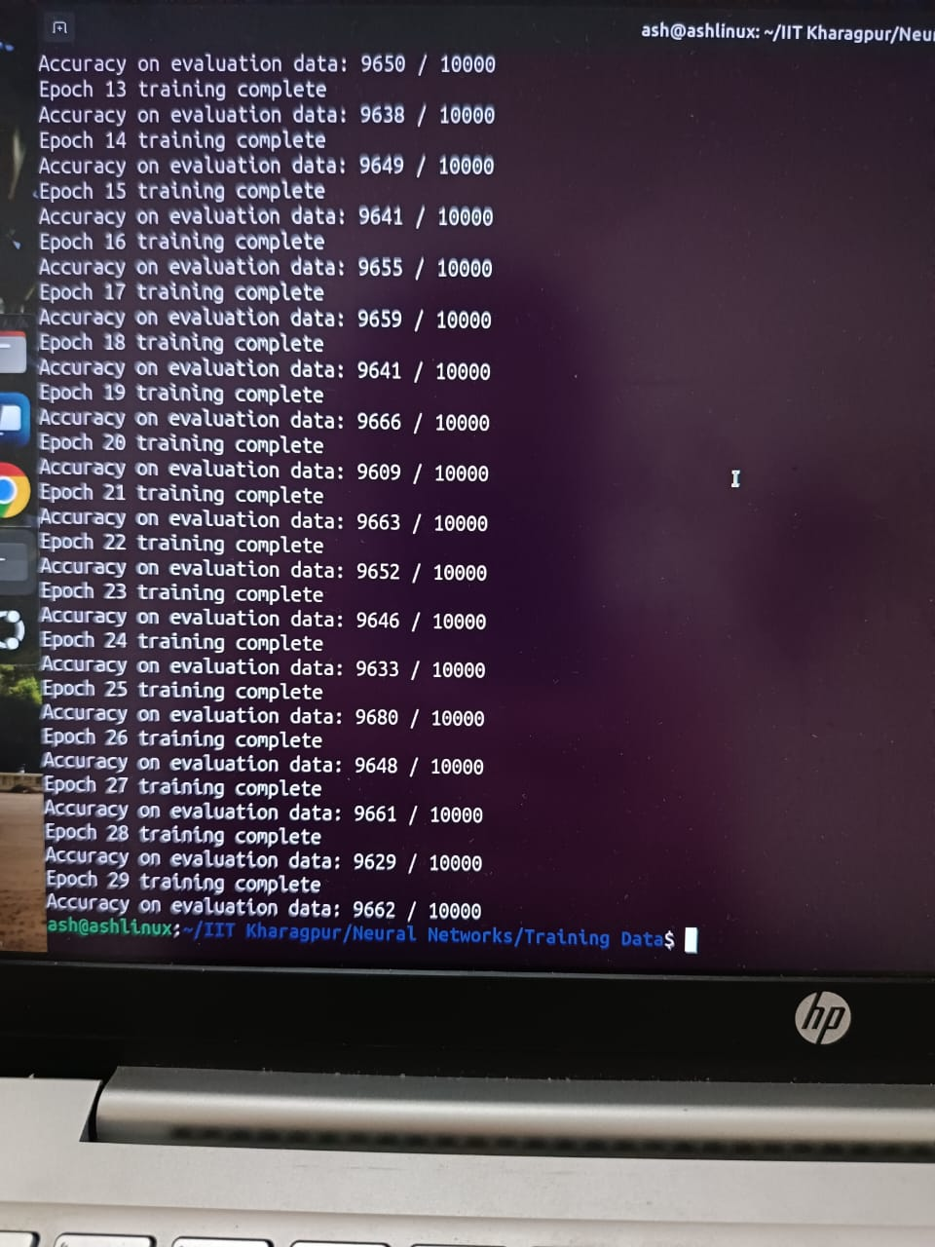
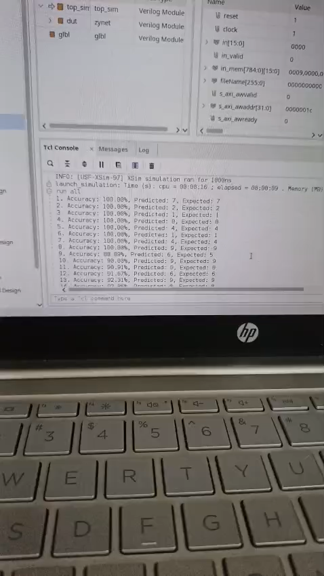
Training and Prediction Simulation Results
Epoch based training 10,000 test data
Above video supports for Sigmoid size 10

Slide 30
Timing Results for different Functions
ReLU
Sigmoid Size 10
Worst Negative Slack : -0.799
Fmax: 208MHz
Accuracy: 90.00000%
Worst Negative Slack : -0.717
Fmax: 212MHz
Accuracy: 98.00000%
*Sigmoid Size 5
Worst Negative Slack : -0.816
Fmax 207MHz
Accuracy: 96.00000%
***Ideally considered: 250MHz

Slide 31
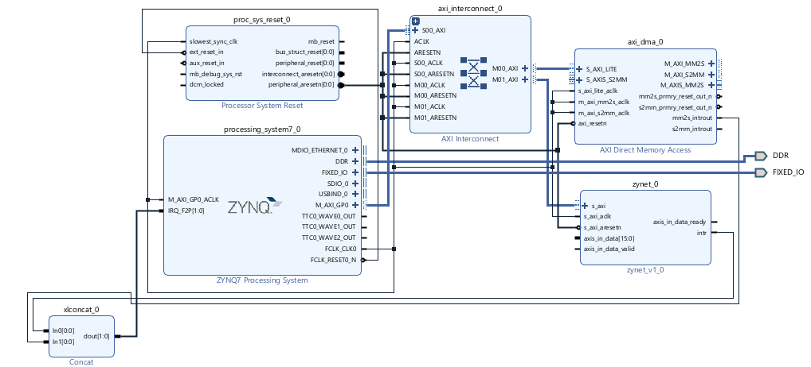
Neural Network IP Block Design (zynet)
Tool used: AMD Vivado 2023.2 IP Packager

Slide 32
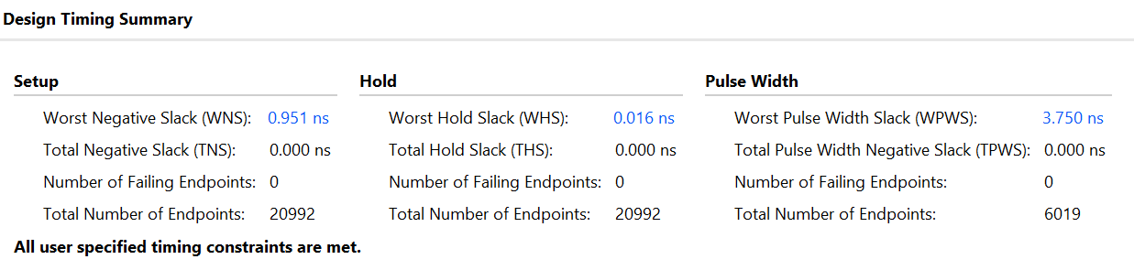
Final Design Timing Summary for zynet IP Block System Design
Worst Negative Slack: 0.951ns
Fmax: 327MHz (higher than 250MHz (considered))

Slide 33
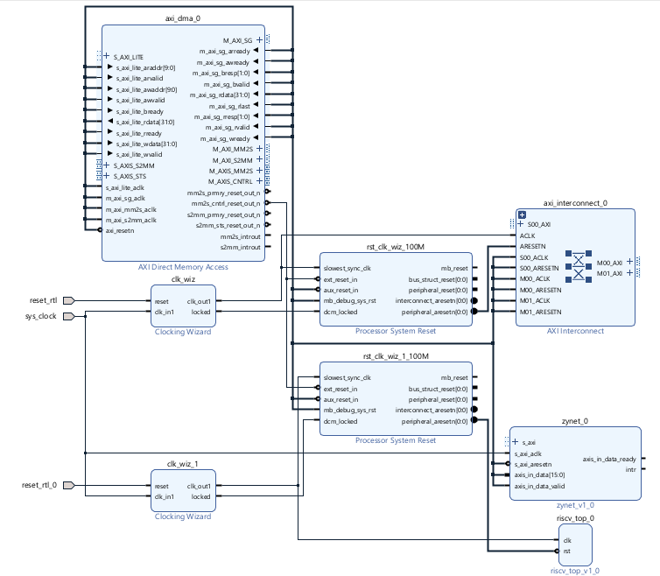
Integration of RISC-V Processor and Neural Networks
***Currently under testing
Tool used: AMD Vivado 2023.2 IP Packager

Slide 34
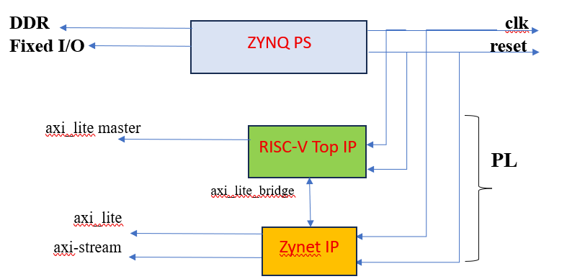
Probable Basic Design of system architecture
Most probable basic structure with type of interfaces

Slide 35
Major Problems Encountered
Failure of AMD Vivado and Vitis softwares multiple times and eventually hanging up of these software in later stages.
Failure of Linux Operating System in later stages.
Availability of RISC-V GNU GCC Complier Toolchain only for Linux OS and not for Windows OS.

Slide 36
Future Task
Try to deploy the whole system architecture on the Zynq 7000 series ZedBoard FPGA Development Board
Try interfacing VGA Controller with a display to manually input image pixel values using arrow keys of a system keyboard.

Slide 37
Extras
Implement Image Processing of a grayscale image of size 512*512 using Verilog HDL initially to find out the edge detection of the input BMP grayscale image.
Test this Image Processing of the same image using Python programming language and deploy it on NVIDIA Jetson Nano board / Texas Instruments MCU CC2650.

Slide 38
Thank You

